Slide 1

COLORING THE TECH SPACE PINK

Slide 2
Outline
Project Description
Objective
Dataset
Dashboard
Insights
Recommendations

Slide 3
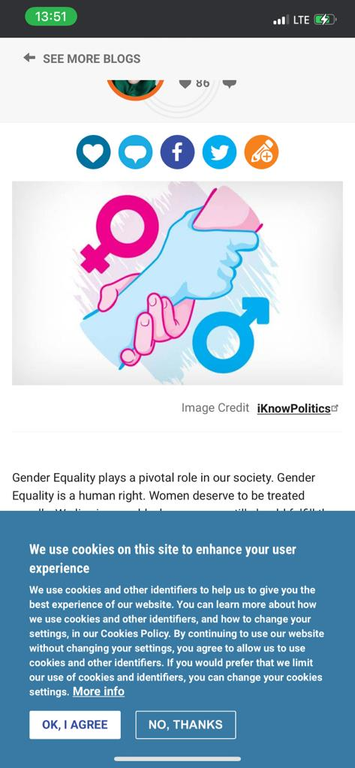
1. Project Description
The female gender is frequently undermined and denied the opportunity to realize her full potential.
The tech world has been largely designed by and for men.
Women have traditionally been excluded from the data story that feeds the development of the products we use(Mobile phone designs and virtual assistants).

Slide 4

2. Objective
To promote UN’s Sustainable Development Goal 5 (Gender Equality) in the tech ecosystem.

Slide 5
3. Dataset
Employee breakdown of key tech companies (2014 – 2018)
Origin of data: data.world
Data cleaning: MS Excel
Data visualization: MS Power BI

Slide 6
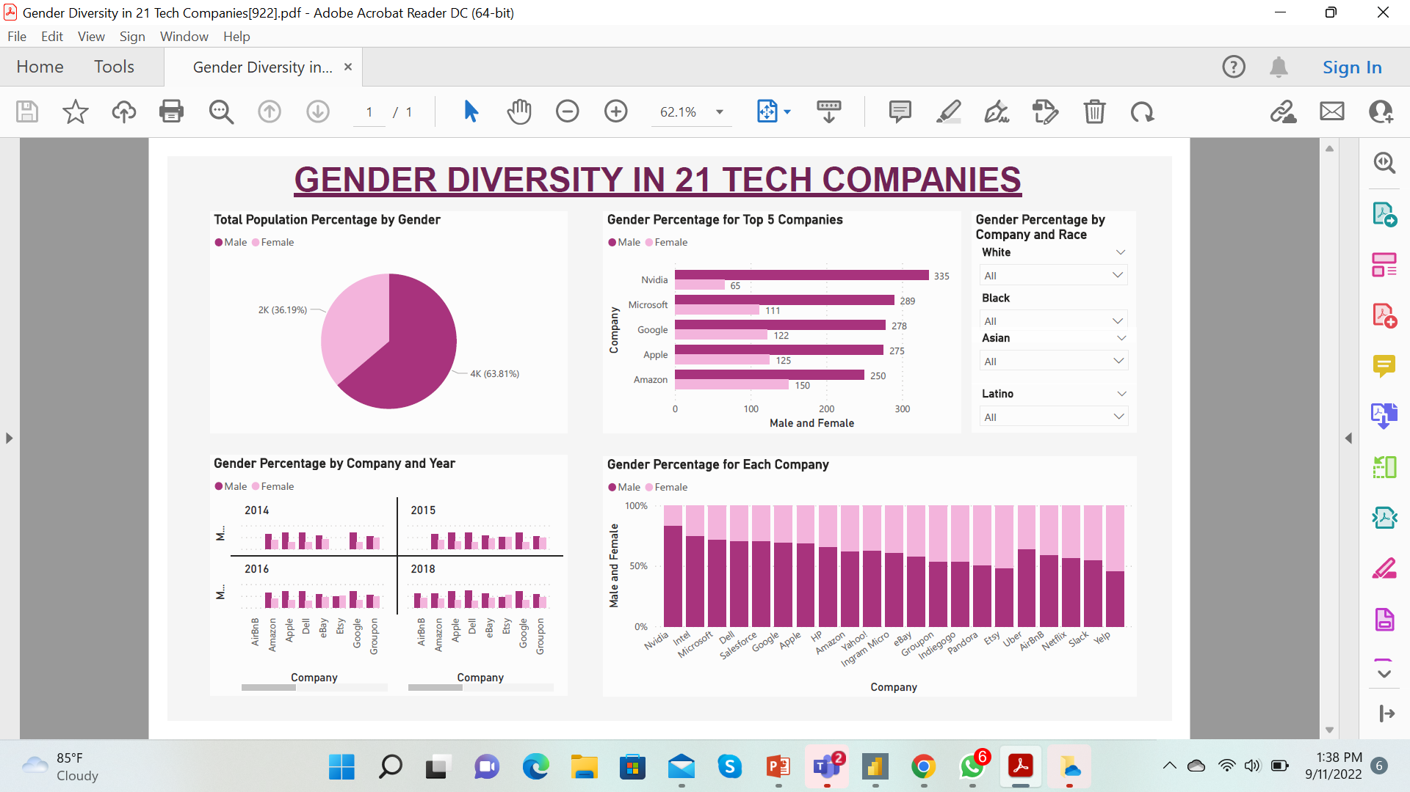
4. Dashboard

Slide 7
5. Insights
Out of the population analyzed in the tech companies, 63.81% were males and 36.19% were females.
Every segment of the analysis showed that male employees outnumbered female employees in all the tech companies.
There was no significant increase in the female population over the years (2014 – 2018).

Slide 8
6. Recommendations
Eliminate gender bias from tech job descriptions.
Support equality from early on—early education on diversity and inclusion.
Create effective women-centric mentoring and training programs (Like the Women Techsters Bootcamp).
Advocate for women in the tech space.

